Slide 1
Tax-Aide Policy and Procedures Review
For Review with All Volunteers Tax Year 2015

Slide 2
Goal
Improve volunteer satisfaction and create a more satisfying experience for taxpayers by ensuring that all sites comply with Tax-Aide policy

Slide 3
Overall Objectives:
Ensure awareness of
IRS grant requirements
AARP Foundation Tax-Aide Program policies and procedures
AARP Foundation Tax-Aide Standards of Professionalism
Provide training for all volunteers
Quality Site Requirements (QSR)
Volunteer Standards of Conduct (VSC)
Program policies and procedures

Slide 4
Policies and Procedures
IRS
AARP Foundation Tax-Aide Program
Standards of Professionalism
Quality Site Requirements
Taxpayer Information and Responsibilities
Volunteer Standards of Conduct
Incident Review Protocol
Notes:
IRS requires training on their two topics as part of grant requirements to fund Tax-Aide program

Slide 5
Key Resource: Client Service Provider Digest
Additional important information provided in the Client Service Provider Digest:
Counselor Guidelines and Policies
Conflict of Interest Guidelines
Confidentiality and Security of Taxpayer Data
Liability Protection
AARP Foundation Volunteer Standards of Professionalism
Activity Reporting
Notes:
The Client Service Provider Digest provides a lot of good information for volunteers and the checked items should be reviewed in detail. Suggest having volunteers open the Client Service Provider Digest and briefly review item.
Client Service Provider Digest can be viewed electronically on OneSupport, or Instructors can order sufficient copies for all volunteers to have a printed copy. The stock number is D16276. Allow 2 weeks to order printed copies.

Slide 6
Summary of IRS Quality Site Requirements (QSR)
 |  | Who is responsible?
1 | Volunteer certification | LC/Instructor
2 | Intake and Interview* | LC/Counselor
3 | Quality Review* | LC/Counselor
4 | Reference Material | LC
5 | Signed Volunteer Agreement | Counselor/CF
6 | All Returns filed on timely basis | LC/ERO
* New for 2015 – all LCs and Counselors must pass test on these subjects
Notes:
Let Counselors and Client Facilitators know that they are responsible for compliance only on the requirements marked in blue, however they should be aware of the other requirements to assist leaders to bring sites into compliance with all requirements. Advise that when IRS does a site review the site will receive a “grade” on each of the requirements; QSR requirements are also reviewed when Tax-Aide leaders do an internal site review.
Client Facilitators or “Greeters” are not required to take the new Quality Review Test. However, they should be familiar with the Quality Review process and be able to explain the process to a taxpayer.

Slide 7
Quality Site Requirements
 |  | Who is responsible?
7 | Taxpayers informed of Civil Rights | LC
8 | Correct Electronic Filing Identification Number (EFIN) | LC/ERO
9 | Correct Site ID number (SIDN) | LC/ERO
10 | Taxpayer Identification | Counselors

Slide 8
What You Need to Know
QSR #1
Volunteer Certification
TRS oversees the Tax-Aide volunteer certification process and ensures that the names of certified Instructors are submitted.
Instructors notify LC and DC of volunteers completing certification.
Volunteer is assigned to site and notification sent to IRS and Tax-Aide National Office and NVP updated
All volunteers must complete Volunteer Standards of Conduct training and pass the test
Notes:
QSR – Quality Site Requirement
VSC – Volunteer Standards of Conduct

Slide 9
What Counselors Need to Know
QSR #2
Intake/Interview Process
Must use current year Form 13614-C – Interview/Intake & Quality Review Sheet for every taxpayer
Ask probing questions to ensure accurate and complete answers
Note new or changed information on form
Goal:
100% use of form with sufficient interview of taxpayer to ensure accuracy and completeness of return
Notes:
Intake form must be completed even for taxpayers who are unlikely to experience any change from year to year, or those who say that nothing has changed. If the taxpayer has difficulty completing the form, the Client Facilitator can assist by reading the questions and/or providing explanation, however a non-certified Client Facilitator can’t provide tax law information.
Volunteer may not ignore information furnished to, or actually known by, the preparer
Preparer needs to ask questions if the information furnished appears to be incorrect, inconsistent, or incomplete
The form documents what happened at the tax site, and assists taxpayers to remember what they told the Counselor. In the event that there is a subsequent disagreement as to what a taxpayer told the Counselor, the intake form serves as the printed record of the conversation for the taxpayer and/or family members.
When a taxpayer later asserts that their return was done incorrectly by a Counselor, the intake form provides critical information as to the discussion between the Counselor and taxpayer.
Counselors should document “changed answers” to critical questions on the intake form to indicate that the return was changed due to additional information provided by taxpayer. This also assist the Quality Reviewer to know what questions were asked and what information was provided by the taxpayer.

Slide 10
What Counselors Need to Know
QSR #3
Quality Review Process
QR must be with taxpayer
Full review and discussion of all pages of Intake Sheet
QR must include probing questions to ensure correct application of tax law, not just verification of name and numbers
Goal:
100% Quality Review by 2nd Counselor
Notes:
See “Gold Standards for Quality Review” document on OneSupport for full details as to how to conduct a quality review.
QR should pay close attention to see that 1) all forms that the taxpayer brings to the site are appropriately entered onto the return and 2) that all information marked on the intake form is correctly documented on return. For example, Interest income could be missed if the taxpayer fails to bring the form but notes on the intake form that they have interest income.
While it is important to maintain an effective flow of taxpayers at a site, it is never appropriate to fail to do a complete Quality Review because it takes too long, or because other taxpayers are getting impatient. Remind waiting taxpayers that when their turn comes that you will be just as thorough in preparing and reviewing their return.

Slide 11
LCs and Counselors
Required to attend training sessions for:
Screening and Interviewing
05 Screening and Interviewing TY15
Quality Review
06 Quality Review TY15
Pass Intake/Interview and Quality Review Test
Notes:
LCs, Shift Coordinators and Counselors must, beginning in 2015, successfully pass the new Intake/Interview & Quality Review test.

Slide 12
What You Need to Know
QSR #4
Reference Material
IRS Pubs 17 and 4012
Appropriate State Tax Instructions
IRS Intake/Interview and Quality Review Sheet (Form 13614-C) for every return prepared
Tax-Aide Cybertax Alerts
Have required IRS material available (paper or electronic)

Slide 13
What Counselors Need to Know
QSR #5
Volunteer Agreement
Must pass Volunteer Standards of Conduct test and Intake/Interview and Quality Review test
Must agree to IRS Standards of Conduct
Must agree to abide by program’s Standards of Professionalism
Volunteer Agreement must be signed by Volunteer and Instructor or Local Coordinator
Goal:
100% volunteers sign Volunteer Agreement Form and understand Standards of Conduct
Notes:
Have copies of the AARP Foundation “Tax-Aide Standards of Professionalism” (on OneSupport) available for all volunteers to review. Advise that violations of either the IRS Standards of Conduct or the Standards of Professionalism will result in an Incident Review, and could result in termination from the program. Slides 17-20 provide more details
Signed originals of Volunteer Agreements are to be retained by District Coordinator or designee

Slide 14
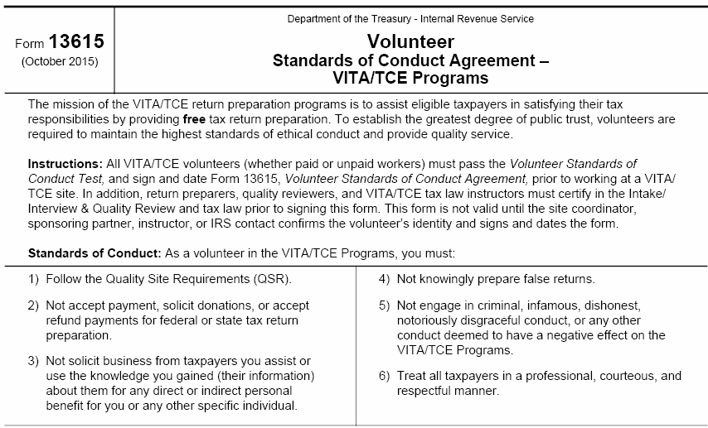
Volunteer Standards of Conduct All volunteers must sign Form 13615 – critical text below
Notes:
The Standards of Conduct are listed on Form 13615 Volunteer Standards of Conduct Agreement – VITA/TCE Programs. This is the document that all volunteers (preparers, Quality Reviewers, greeters, Client Facilitators, etc.) have to sign.

Slide 15
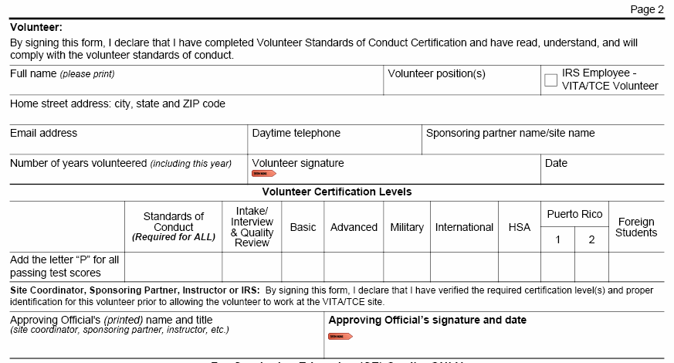
Form 13615, Page 2
Electronic OK
Must be Handwritten
Notes:
Note that this form is also used to request that the IRS grant Continuing Education credits to volunteers who are CPAs or paid tax preparers. The bottom portion of the form should be completed by the volunteer and given to his/her supervisor to review and approve. Credit can be requested for 1) providing Quality Review at a tax site 2) providing instruction in specified tax topics or 3) preparing returns at tax sites. Once approved by the volunteer’s supervisor, it should be forwarded to the National Office for review. Requests for CE credit for Training can be done after the training is complete however requests for either return preparation and/or Quality Review should be sent no earlier than April 15 and no later than September 1.

Slide 16
IRS Volunteer Standards of Conduct
#1: Follow the Quality Site Requirements
#2: Do Not accept payment or solicit donations for federal or state tax return preparation
#3: Never solicit business for self or others
#4: Do Not knowingly prepare a false return
#5: Do Not engage in any criminal or any conduct deemed to have a negative effect on the program
#6: Treat all taxpayers in a professional, courteous and respectful manner
Notes:
The Standards of Conduct are listed on Form 13615 Volunteer Standards of Conduct Agreement – VITA/TCE Programs. This is the document that all volunteers (preparers, Quality Reviewers, greeters, Client Facilitators, etc.) have to sign.

Slide 17
AARP Foundation Tax-Aide Standards of Professionalism
Discussions of politics, race, nationality, gender identity, religion are inappropriate.
Treat all taxpayers/volunteers equally and with courtesy – no discrimination
Only prepare “in-scope” returns
All tax returns will receive a Quality Review by 2nd certified Counselor

Slide 18
Standards of Professionalism
Do not discuss taxpayer information with anyone who does not have a “need to know”
When issue arises regarding taxpayer return that requires consultation with 2nd volunteer:
Discuss away from taxpayer
Discuss quietly to ensure other taxpayers do not hear private information
Resolve differences of opinion privately to sustain taxpayer confidence in the knowledge and skills of the Counselors

Slide 19
Standards of Professionalism
Angry taxpayer?
Attempt to diffuse situation
Move to quiet area, if possible
Immediately notify Local Coordinator
Provide assistance to those with disabilities
Assure welcome
Requested assistance not available, notify Local Coordinator
Do not provide personal information for any volunteer
Refer inquiries to Local Coordinator

Slide 20
What Counselors Need to Know
QSR #6
Timely Filing of Tax Returns
Both taxpayer and spouse must sign Form 8879 to authorize e-file of return —Counselors may never sign for a taxpayer
All Counselors must inform taxpayer that he/she is responsible for accuracy of return before signing 8879
Any rejects should be resolved in timely manner (usually within 3 days)
Goals: 100% taxpayers are reminded that the accuracy of the return is their responsibility
Returns filed in timely manner
Notes:
Remind taxpayer of their responsibilities by emphasizing key words from Form 8879 statement as you request they sign the document. Confirm with the taxpayer that he/she agrees that the return is:
true, correct, complete, OK to file

Slide 21
What You Need to Know
QSR #7
Title VI
AARP Poster (D143)
* Trash or re-cycle old posters!
Must display at “first point of contact between volunteer and taxpayer.”
Sites must provide information to taxpayers regarding their Civil Rights.

Slide 22
What Counselors Need to Know
QSR #8 All Returns must have the correct Site Identification Number
QSR #9 All Sites must have the correct Electronic Filing Identification Number
Notes:
Counselors should talk to the LC at their site to ensure that the process has been set up with the correct information for their site. Volunteers who work several sites should not change information for a site without consulting with the LC

Slide 23
What Counselors Need to Know
QSR #10
Security, Privacy, Confidentiality
All taxpayers should show photo ID and SS cards for all people on return*
No taxpayer forms or information should be retained by volunteers
All returns must be prepared at site
Promptly report any lost data to National office
*rare exceptions approved by LC
Goals:
100% taxpayer identification
No loss of taxpayer data
Notes:
*Notes:
Must have photo ID – Exceptions ONLY by LC in “Extreme Conditions”. Do not need Photo ID if the taxpayer is “immediately known by first and last name” by volunteers and presents SSN card or other tax forms to verify identity. This provision does not cover the situation where a taxpayer is casually known or simply recognized by the volunteers.
Alternates for SS Verify – Income Statements (1099-SSA), Letters from SS or other SS documents.
Can also use Carry-forward data from TaxWise, if TP has Government Photo ID
Remind that this policy is critical to ensure the safety of the taxpayer’s financial data—any volunteer who violates this policy can be terminated from the program.

Slide 24
What Counselors Need to Know
QSR #10
Security, Privacy, Confidentiality
Know and comply with password requirements
Never post password on or near computer
Lock computer if you step away; turn screen so can’t be seen by someone other than taxpayer
Restrict cell phone usage; prevent photos of financial data
Don’t talk about a taxpayer’s return where others can hear
Goal:
All taxpayer financial data is secure
Notes:
Password guidelines:
Minimum length – eight (8) characters for Windows, and TaxWise™ accounts.
At least one letter and one number in the password.
Choose a password that is not a dictionary word or someone’s name.
Do not use TaxWise, TW, Tax-Aide, AARP or any word in the password similar to something that is obviously related to the program

Slide 25
Security of Taxpayer Information
During follow-up on rejected return
Tax-Aide volunteer should clearly identify himself/ herself including when and where return was prepared
Volunteer should obtain information such as birth date, details of an income document, etc. to verify that person is actual taxpayer
Do not include any taxpayer personal information (other than name) in an email
Notes:
Provide taxpayer assurance that you are Tax-Aide volunteer
Ensure you are talking to taxpayer

Slide 26
Security of Taxpayer Information
Do not retain any taxpayer data at any time other than for Form 8453
Do not exchange taxpayer data with anyone by email, by fax, by mail or by courier
Notes:
No retention of taxpayer data – not a signed Form 8879 just in case, no copies of W-2s, NOTHING – not even for an hour or a day or a couple of days!

Slide 27
Secure Equipment and Tax Data
AARP Foundation Tax-Aide approved anti-virus software must be installed and running on computers
AARP Foundation Tax-Aide approved firewall software program installed
Passwords required to control access to taxpayer data
Notes:
The Local Coordinator works with the Technology coordinator to assure that all equipment and software is secure. If Counselors see something on their computer that seems unusual or concerning, report it to the LC.

Slide 28
Loss of Equipment/Financial Data
Store equipment in secure environment when not in use (ask: who has access to this storage room?)
Immediately notify your volunteer leader if:
Computer is stolen or lost
Forms with taxpayer data are stolen, lost or a taxpayer has unauthorized access to another taxpayer’s documents
Volunteer leader must immediately call police to report loss of computer and number on back of volunteer badge
Incident Review must be completed and sent to volunteer supervisor and National Office
Notes:
See documents on One Support that explain when and how to file an Incident Review.

Slide 29
Summary: All Volunteers Must
Complete Volunteer Site Policies and Procedures Training
Pass the IRS Volunteer Standards of Conduct test
Wear name tag with first name and first initial only of last name

Slide 30
Summary: All Counselors Must
Pass IRS Intake/Interview and Quality Review and Advanced tests
NOT prepare returns that are “out of scope” for Tax-Aide
NOT prepare a return for which they are not trained or do not have sufficient knowledge to prepare, even if it is “in-scope” (refer to another Counselor)
NOT prepare a return if they believe that the taxpayer is not truthful about the information provided (advise return can’t be completed)
Notes:
The previous chart have applied to all volunteers. This chart applies to Counselors i.e. tax preparers.
For more information on what tax topics and forms are In-scope and Out of Scope for Tax-Aide, refer to the Scope Manual, found on the OneSupport. Volunteers who prepare a return that contains tax topics and/or forms that are out of scope are NOT covered by the Volunteer Protection Act, and may be terminated from the program for failure to follow Tax-Aide policy.
Volunteers are permitted to use TaxWise software to prepare their own tax returns, and those of close family members, even if they contain topics and/or forms that are out of scope.

Slide 31
Tax-Aide Policy re: Shut-Ins
Only for taxpayers with disabilities who are unable to come to a tax site, generally as a result of lack of mobility
For reimbursement:
Taxpayer must be age 60 or older
Federal tax assistance must be provided
Mileage limited to 30 miles round-trip
Completed no later than April 15th
Notes:
State Coordinators have the discretion to limit or deny Shut-in service if necessary due to limited resources of volunteers or high volumes at tax sites.
If a facility such as a Nursing home or Assisted Living Facility requests Shut-In service, consider establishing an Ad hoc site for 1 or 2 days to serve all taxpayers in facility

Slide 32
Shut-Ins
Requires presence of two Counselors for QR and to reduce potential liability issues
Need computer, printer and internet access
Preferred alternative
Power of Attorney provided by taxpayer to friend/relative who can come to site

Slide 33
Reduce Errors on Bank Deposit Information
Bank routing number and account number should be entered directly from check—must not be taken verbally or from handwritten note
If taxpayer does not have check, use optional method only if approved by Local Coordinator

Slide 34
Reduce Errors on Bank Deposit Information (Optional Method)
Counselor advises taxpayer that he/she is responsible for accuracy of information and money will likely be gone for good if incorrect numbers are provided
Taxpayer initials next to routing and account numbers on printed return to confirm they accept responsibility for accuracy
Source of information recorded in TaxWise
Main Information Sheet
Taxpayer Diary
Notes:
Optional Method use must be authorized by LC from DC – It is not an individual Counselor option.

Slide 35
Closing for the Season
Ensure no taxpayer data remaining on site-owned, personal, IRS and Tax-Aide computers
Scanned files
Print spoolers
See OneSupport for details

Slide 36
Final Reminders: Volunteer Checklist
Secure Equipment and Tax Data
Certify. Pass Intake/Interview & QR test and Advanced test if a Counselor; IRS Standards of Conduct Test (all volunteers)
Follow key policies, e.g. IRS Standards of Conduct, AARP Foundation Standards of Professionalism
Interview/Intake process for every taxpayer
100% Quality Review by 2nd Counselor
Close for the day; have and comply with a process for tracking all e-files through acceptance – get returns to ERO
Close for the season properly
Accurately Report Service Activity – Include Q & As!

Slide 37
Volunteer/Site Policies and Procedures
Questions?
Comments…

